Slide 1
Multi-Robot Perimeter Patrol in Adversarial Settings Noa Agmon, Sarit Kraus and Gal A. Kaminka Department of Computer Science Bar Ilan University, Israel {segaln, sarit, galk}@cs.biu.ac.il
Presenter: Solomon Ayalew

Slide 2
Introduction
Multi robot patrol in a closed area with the existence of an adversary
Traditional approach is Visit the area frequently
If robots move in a deterministic way: Penetration is easy

Slide 3
Introduction cont.
This paper:- Non deterministic Algorithm for a team of Homogenous patrol robots
Divide the perimeter in to segments i
robot monitors 1 segment i per unit time cycle
robot @ segment i have 3 choices
Go to segment i-1 or i+1 or stay there (i)

Slide 4
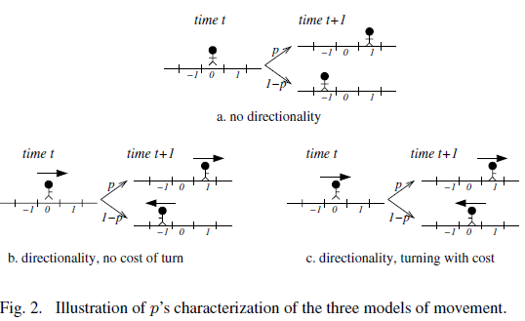
Movement models
3 movement models
DZCP : Directional Zero Cost Patrol
BMP : Bidirectional Movement Patrol
DCP : Directional Costly-Turn Patrol

Slide 5
Adversarial model
Adversarial model
The adversary is strong (has full knowledge of the system)
Know the patrol scheme
# of robots, distance between them, their current position
Movement model of robots & characterization of their movement
Can be learned by
observing for sufficiently long time
Assume worst case scenario

Slide 6
Goal
Robots are responsible for detection not handling
Multiple penetration is the some as single penetration
Adversary tries to penetrate @ the weakest spot in the cycle
Main goal:
Find a patrol algorithm that maximizes penetration detection in the weakest spot

Slide 7
Algorithm
Algorithm is characterized by a probability p
p could be 1 => deterministic
So 0 <= p <= 1

Slide 8
Border Penetration Detection (BPD) problem
Given
Circular fence of length l divided in to N segments
K robots uniformly distributed with d distance
d = N/k
Assume : it takes t time units for the adversary to penetrate

Slide 9
cont.
let f_{i}(p) =ppd_{i} , 1 ≤ i ≤ d − 1
ppd_{i} : probability of penetration detection
Probability that a segment will be visited at least ones during t time units

Slide 10
Cont.
find optimal P_{opt} such that the minimal ppd throughout the perimeter is maximized

Slide 11
Cont.
Lemma 1: given p, func ppd_{i} (R_{a}) for const t & R_{a} @ segment s₀ is montoic decreasing func.
As distance b/n a robot & a segment probability of arriving in it during t time units decrease
Lemma 2: if distance between two consecutive robots is smaller, the ppd in each segment is higher & vice versa

Slide 12
Cont.
Lemma 3: team of k mobile robots in mission maximizes minimal ppd if:
The time distance b/n every two consecutive robot is equal
The robots are coordinated:
Move in the some dxn
All change dxn @ the some time

Slide 13
Algorithm to find p_{opt}
1st find the detection probability in each segment
2nd manipulate these equations to find p_{opt} (maxmin point)
Complexity of algorithm is in polynomial time

Slide 14
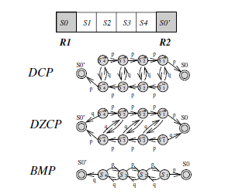
Finding the equation

Slide 15
Cont.
p of reaching a certain state in time r is the sum of probabilities of reaching in state s_{j} multiplied by p of being in state s_{j} @ time r-1

Slide 16
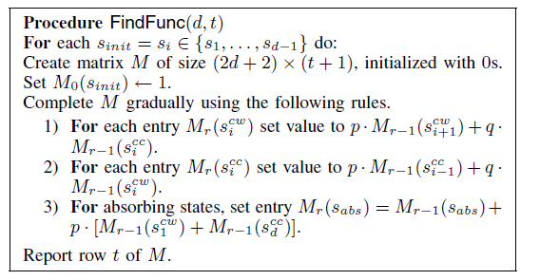
Cont.
.

Slide 17
Cont.
Time complexity:
FindFunc is d.(2d+2).(t+1). Since t is bounded by d-1 & d=N/k
➔ complexity is O((N/k)³)
Next find maxmin point
Is the value that lies inside the intersection of the all integrals of f_{i}

Slide 18
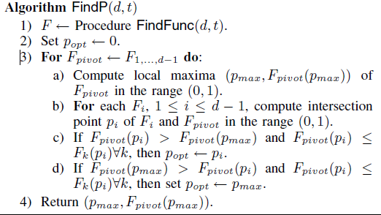
Algorithm 2

Slide 19
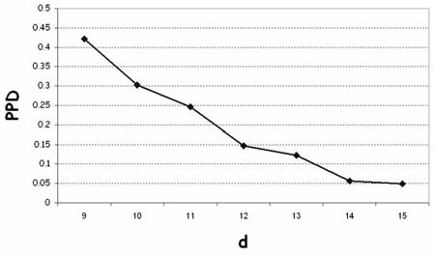
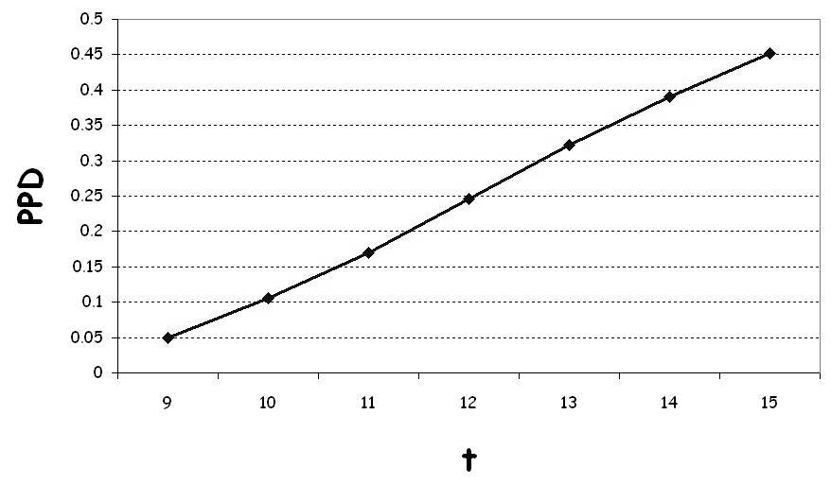
Result

Slide 20
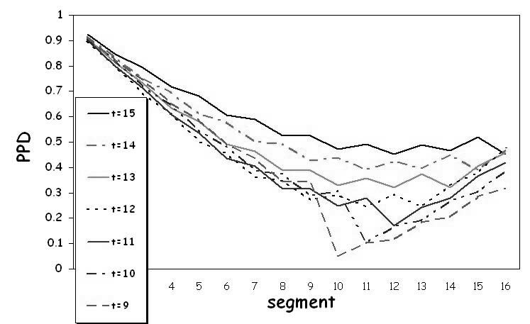
Cont.

Slide 21
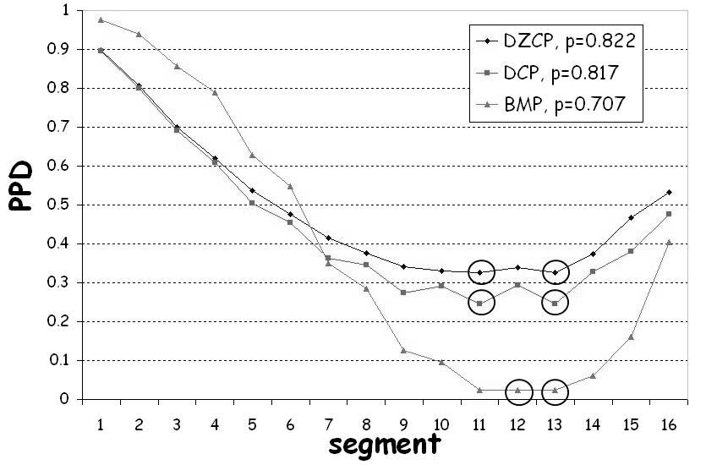
Cont.

Slide 22
Conclusion and future work
Non- deterministic algorithm under strong adversary
Polynomial time complexity
Continuous case rather than discrete model
More realistic movement models
With arbitrary tuning time

Slide 23
Cont.
Other adversarial models
Case of unknown adversary similar to Bayesian games
Adopt this algorithm in other domains
e.g. Area patrol

Slide 24
.
?

