Slide 1
Presented by: Pingal Sapkota

Slide 7
Classical Planning

Slide 12
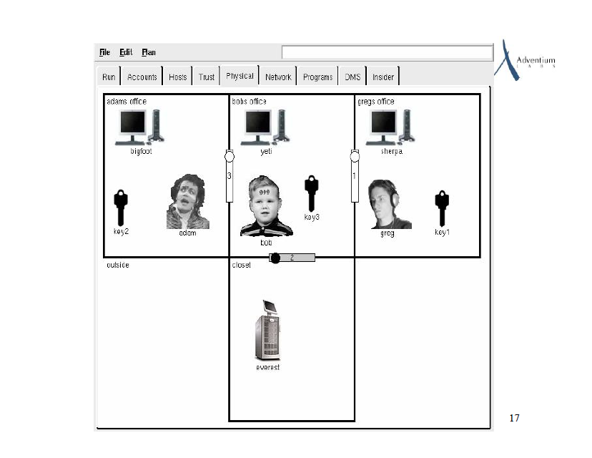

Slide 16
Forward Heuristic Search
Hoffmann’s metric FF planner
Enhanced hill climbing (EHS)
Breadth first search (BFS)
Ignores mutexes
Very effective for many domains

