Slide 1
Improved Human-Robot Team performance using Chaski
Proceeding:
HRI '11 Proceedings of the 6th international conference on Human-robot interaction Authors: Julie Shah, MIT James Wiken, MIT Brian Williams, MIT Cynthia Brazeal, MIT
Presented by: Mohammed Imran Khan

Slide 2
OUTLINE
Goal is to develop robot partners that we can work with more easily and naturally as inspired by the way we work with other people.
Test whether human-robot team performance is improved when a robot teammate emulates the behaviors and teamwork strategies observed inhuman teams.
WHAT IS CHASKI?
Multi-agent executive for scheduling temporal plans with online task assignment.
Enables a robot to collaboratively execute a shared plan with a person.

Slide 3
Features of Chaski
Chaski enables an agent to dynamically update its plan in response to disturbances in task assignment and the schedule of other agents.
The agent then uses the updated plan to choose, schedule and execute actions that are guaranteed to be temporally consistent and logically valid within the multi-agent plan.
Chaski makes task assignment and scheduling decisions ten times faster compared to prior work.

Slide 4
Basic implementation of Chaski
The system’s key innovation is a fast execution algorithm that operates on a compact encoding of the scheduling policies for all possible task assignments.
Chaski is made efficient through an incremental algorithm that operates on changes in the environment variables.
Helps agents to make decisions on the fly.

Slide 5
Chaski Problem statement
Chaski takes as its input a multi-agent plan composed of P=(A,V,C,L), where A is a set of agents, V is a set of activities, A→V is an function describing the set of feasible activities and temporal capabilities of each agent, C is a set of temporal constraints over activities, and L is a set of logical constraints.
The output of Chaski is a dynamic execution policy that guarantees temporally consistent and logically valid task assignments

Slide 6
Disjunctive Temporal Constraint Networks
STN: set of variables X1,…Xn, representing executable events. Events have real-valued domains and are related through binary temporal constraints. (X_{k} – X_{i} ) ε [a_{ik,} b_{ik}].
A solution to an STN is a schedule that assigns a time to each event such that all constraints are satisfied.
A Disjunctive Temporal Constraint Network, otherwise known as a Temporal Constraint Satisfaction Problem (TCSP), extends an STN by allowing multiple intervals in constraints
(X_{k} – X_{i} ) ε P({[a_{ik,} b_{ik}] | a_{ik} < b_{ik} } ); Determining consistency is NP hard.

Slide 7
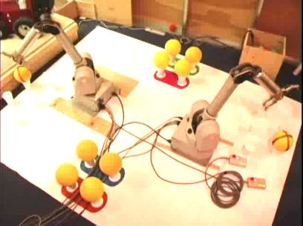
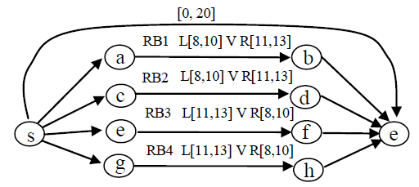
Example
Remove one ball each from all locaction.
Removing a ball from Loc. #1 or #2 takes the left robot takes 8-10 seconds and takes the right robot 11-13 seconds

Slide 8
HHI as a guide for HRI
Best performance is achieved when robot emulates the effective coordination behaviors observed in human teams.
SET OF DESIGN REQUIREMENTS FOR THE CHASKI SYSTEM
Teammates make decisions on-the-fly
Teammates frequently communicate progress on the task.
Teammates consider the consequences of their actions on others.

Slide 9
Design requirements for Human-Robot Teaming
Chaski should take as input a shared plan that serves the same purpose as the shared mental model within a human team.
Chaski should enable a robot to choose just before execution which activities to perform and when.
Chaski should enable a robot to reason about the consequences of its actions on human teammates by favoring execution times that minimize the humans idle time

Slide 10
Modeling system of equal partners
Decision making authority and timing
Decision making strategy – Decisions on the fly
Communicative acts - Communicate with team members updating the status of the task

Slide 11
Problem statement : Equal partners plan
Activities to be performed
Ordering constraints among the activities
Plan deadlines.
Capabilities of the team members

Slide 12
Output
The output of Chaski is a dynamic and least-commitment policy, if one exists, for making task assignment and scheduling decisions.
The policy ensures the team members work together to assign, schedule, and execute activities within the plan deadlines.
The policy also includes a preference for task assignments and activity orderings that minimize a lower bound on the humans’ idle time.

Slide 13
Technical Challenges
High-tempo domains
Reassignment of three or four activities introduces time-consuming computations requiring tens of seconds.
Many multi-agent systems employ an offline planning process to assign and order activities, but then enable the agents to schedule the precise timing of their activities online

Slide 14
HUMAN-ROBOT TEAMING EXPERIMENTS
Experiment testing the hypothesis that human-robot team performance is improved when a robot teammate uses Chaski.
Implicit Teaming group Vs. Explicit Teaming group
Goal:
Chaski improves objective measures of team performance.
Chaski improves subjective measures of teaming quality.

Slide 15
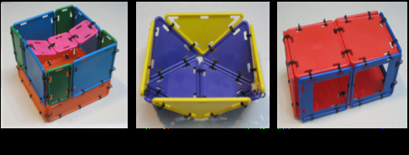
Method
The participants consisted of 16 people so 16 teams.
The materials for the middles and tops of the structures were located in bags distributed on the floor within the experiment workspace. However, either the human or robot was permitted to retrieve the bags with materials.

Slide 16
Rules
Each team member may retrieve only one bag at a time
The human teammate is allowed to retrieve up to one bag between building each structure.
Teammate must follow through with an activity once he has communicated a commitment to perform the activity.
Human teammate must finish gathering materials for and finish building Structures 1 and 2 before starting to build Structure 3.

Slide 17
Team Capabilities

Slide 18
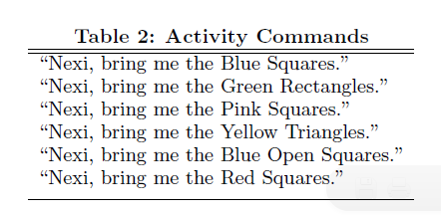
Activity Commands
human participants were asked to rate their agreement with the statements which addressed robots performance and other factors.
1. Nexi’s performance was an important contribution to the success of the team.
2. Nexi performed well as part of the team.
3. Nexi contributed equally to the team performance.
4. I felt like Nexi was committed to the success of the team.

Slide 19
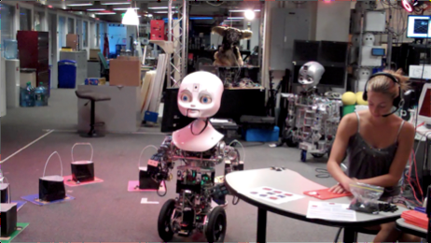
Experiment Setup and Robot Platform
Vicon Motion capture system – position and orientation
Sphinx-4 – Speech recognition system

Slide 20
Results
Comparison of human idle time, time to complete the task and subjective measures.
Idle time :
Implicit : 5 sec first trial and 8 sec in second trial
Explicit : 45 sec first trial and 43 sec in second trial
Time to complete task:
Implicit : 13.6 min first trial and 11.2 min in second trial
Explicit : 15.4min first trial and 12.1min in second trial

Slide 21
Subjective measures
People in the Implicit Teaming group agreed with statement “the robot is trustworthy,” more strongly than people in the Explicit Teaming group.
No statistically significant differences were found for responses to the other statements.
Sample responses of Explicit group : “[Fluency of teamwork] largely depended on my foresight and ability to multi-task. If I asked for material out of order, it was my fault.”
Implicit Group: “Nexi understood everything that I said and she knew what materials I needed, and in what order, to build all the structures. I think it was great (and helpful) that I didn’t have to ask for specific materials.”

Slide 22
Conclusions
Human participants in the Implicit Teaming group spent 85% less time idling, on average, than human participants in the Explicit Teaming group.
Human idle time was reduced from 44 seconds to 6 seconds, on average
Analysis also indicates that Implicit Teaming groups performed the task 7-12% faster, on average, than Explicit Teaming groups.
Participants in the Implicit Teaming group agreed with the statement “the robot is trustworthy” more strongly than people in the Explicit Teaming group

Slide 23
References
Improved Human-Robot Team Performance Using Chaski, A Human-Inspired Plan Execution System.- Julie shah, James Wiken and Brian Williams
Human-Robot Interactive Planning using Cross-Training: A Human Team Training Approach - Stefanos Nikolaidis and Julie Shah
Fast Distributed Multi-agent Plan Execution with Dynamic Task Assignment and Scheduling - Julie A. Shah, Patrick R. Conrad, and Brian C. Williams

