Slide 1
Can Cloud Computing be Used for Planning? An Initial Study
Authors: Qiang Lu*, You Xu†, Ruoyun Huang†, Yixin Chen† and Guoliang Chen* from
*University of Science and Technology of China
†Washington University in St. Louis
In Proceedings of the 3rd IEEE International Conference on Cloud Computing Technology and Science (CloudCom-11), 2011.
Speaker: Lin Liu from Dept. of ECE, MTU

Slide 2
Outline
Cloud Computing
MRW
PMRW
Enhanced PMRW
Implementation in Windows Azure
Experimental Results
Conclusions

Slide 3
What is Cloud Computing?

Slide 4
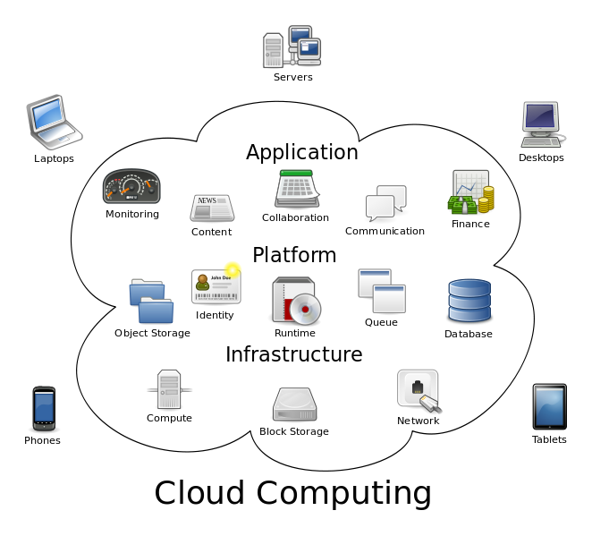
Cloud Computing
Cloud Computing is a general term used to describe a new class of network based computing that takes place over the Internet
It is a collection/group of integrated and networked hardware, software and Internet infrastructure (called a platform)

Slide 5
Cloud Computing
Advantages
Low cost
High availability, scalability, elasticity
Free of maintenance
Disadvantages
High latency
Security

Slide 6
Parallel Search Algorithms
Search is a key technique for planning
The reported parallel algorithms are not suitable for the cloud environment

Slide 7
Portfolio Search
A portfolio of algorithms is a collection of different algorithms and/or different copies of the same algorithm running in parallel on different processors or interleaved on one processor

Slide 8
Monte-Carlo Random Walk (MRW)

Slide 9
MRW Runtime
Two runs with different random seeds have significantly different running time

Slide 10
Portfolio Search With MRW
It is common to observe that a MRW run with a different random seed solves the same instance much faster than another one
Such a large variability can benefit a portfolio scheme that makes multiple independent runs and terminates as soon as one run finds a solution

Slide 11
PMRW
As soon as a processor finds a solution, all other processors will be halted.
The solution time of PMRW is the minimum running time of the N independent runs.

Slide 12
Enhanced PMRW (PMRW^{ms})
PMRW^{ms} is a strategy that takes in a candidate configuration set $C=\{c_{0}, c_{1},…,c_{n}\}$
Each processor $p_{i}$ performs search independently and simultaneously using the setting $c_{i}$
Details are neglected due to time limitation.

Slide 13
Implementation In Windows Azure

Slide 14
Experimental Results
Evaluation in a local cloud
Evaluation in Windows Azure

Slide 15
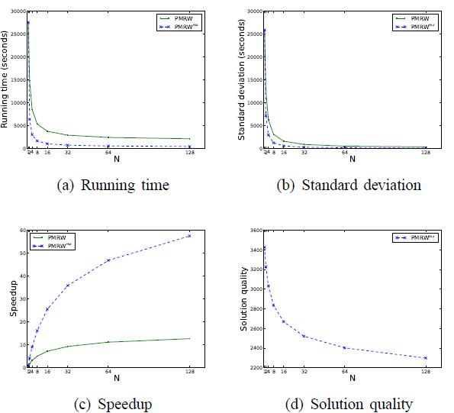
Evaluation In A Local Cloud

Slide 16
Evaluation In Windows Azure

Slide 17
Conclusions
A portfolio search algorithm which is suitable for cloud computing is proposed
The portfolio of MRW algorithm is implemented in a local cloud and the Windows Azure platform
The proposed algorithm is economically sensible in clouds and robust under processor failures

Slide 18
Thanks!
Q & A

