Slide 1
Autonomous Driving in Urban Environments: Boss and the Urban Challenge
Journal of Field Robotics Special Issue: Special Issue on the 2007 DARPA Urban Challenge, Part I Volume 25, Issue 8, pages 425–466, August 2008
CMU, GM, Caterpillar, Continental, Intel
Chris Urmson, Joshua Anhalt, Drew Bagnell Chris Urmson, Joshua Anhalt, Drew Bagnell, Christopher Baker, Robert Bittner,M. N. Clark, John Dolan, Dave Duggins, Tugrul Galatali, Chris Geyer, Michele Gittleman, Sam Harbaugh, Martial Hebert, Thomas M. Howard,Sascha Kolski, Alonzo Kelly, Maxim Likhachev, Matt McNaughton,Nick Miller, Kevin Peterson, Brian Pilnick,Raj Rajkumar, Paul Rybski, Bryan Salesky, Young-Woo Seo, Sanjiv Singh, Jarrod Snider,Anthony Stentz, William Whittaker, Ziv Wolkowicki, Jason Ziglar Hong Bae, Thomas Brown, Daniel Demitrish, Bakhtiar Litkouhi, Jim Nickolaou, Varsha Sadekar, Wende Zhang,Joshua Struble and Michael Taylor, Michael Darms, Dave Ferguson
Presenter Fan Shen

Slide 2
OUTLINE
Introduction
Moving Obstacle Detection and Tracking
Curb Detection Algorithm
Intersections and Yielding
Distance Keeping and Merge Planning
Lessons learned
Conclusion

Slide 3
Urban Challenge
Launched by DARPA(Defense Advance Research Project Agency)
Develop Autonomous vehicles
Target: US military ground vehicles be unmanned by 2015

Slide 4
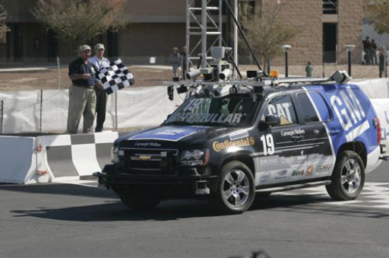
BOSS
Team from CMU, GM, Caterpillar, Continental, Intel
Modified from 2007 Chevrolet Tahoe to provide computer control
Equipped by drive-by-wire system
Controlled by CompactPCI with 10 2.16GHz Core2Duo CPU
Won 2007 urban challenge

Slide 5
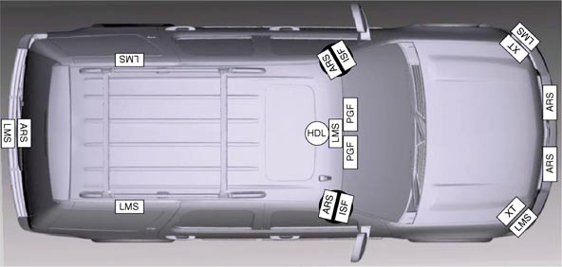
Sensors

Slide 6
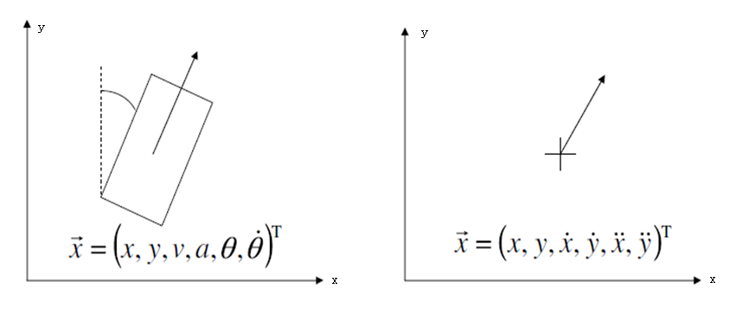
Moving Obstacle Detection and Tracking
Fix shape rectangular model Point model

Slide 7
Object classification
moving or not moving
Moving flag is set when a speed is detected
Observed moving or not observed moving
Observed moving flag is set when keep moving more than a period of time

Slide 8
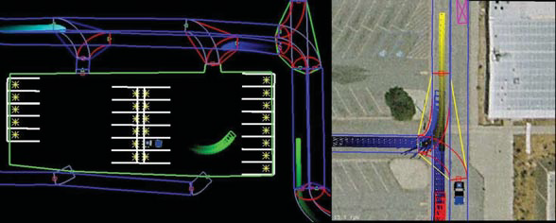
Predicts the motion of tracked vehicles

Slide 9
Curb detection algorithm
Wavelet-based feature extraction

Slide 10
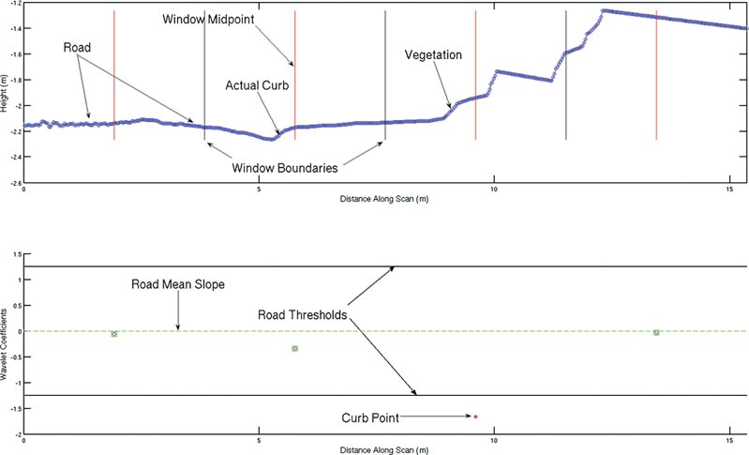
Wavelet-based feature extraction

Slide 11
Wavelet-based feature extraction
Collect coefficients for the current level i
Label each coefficient with label of level i-1
Compute using these labels
1 if y[n]- >=di
Class(y[n], i)=
0 otherwise

Slide 12
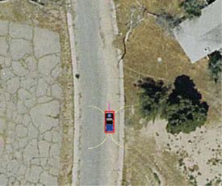
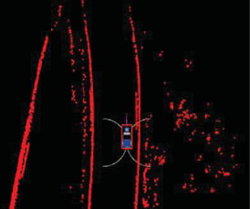
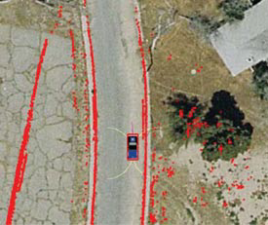
Performance of the algorithm

Slide 13
Intersections and Yielding
Intersection-Centric Precedence Estimation
Yielding

Slide 14
Intersection-Centric Precedence Estimation

Slide 15
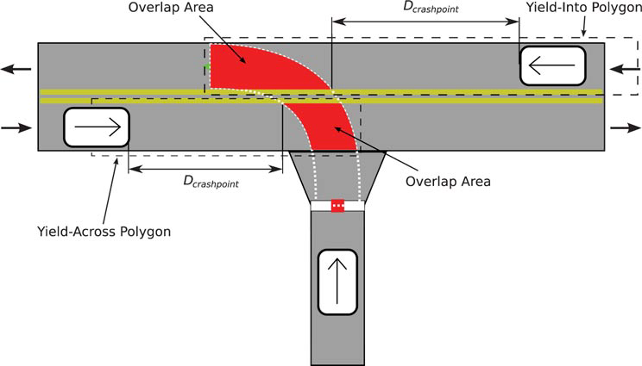
Yielding
T required =Tact+Tdelay+Tspace
L yeild polygon=V maxlane · T required +d safety
Tarrival=dcrash / vobstacle
Tarrival> T required

Slide 16
Distance Keeping and Merge Planning
Distance Keeping
Merge Planning

Slide 17
Distance Keeping
vcmd=Kgap·(dtarget-ddesired)
ddesired=max(vtarget·lvehicle/10, dmingap)
acmd=amin+Kaccvcmd·(amax-amin)

Slide 18
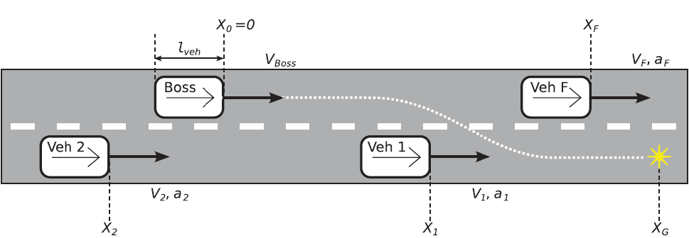
Merge Planning
dmerge=12m
dobst=v0·dinit/(v0-v1)
X0-lvehicle-X1>=max(v1·lvehicle/10, dmingap)
X1-lvehicle-X0>=max(v1·lvehicle/10, dmingap)

Slide 19
Lessons Learned
Sensors are insufficient for urban driving
Road shape estimation maybe replaced by estimating position relative to the road
Human level driving require a rich representation
Validation and verification of the system is an unsolved problem
Driving is a social activity

Slide 20
Conclusion
A moving obstacle and static obstacle detection and tracking system
A road navigation system that combines road localization and road shape estimation where road geometry is not available
A mixed-mode planning system that is able to both efficiently navigate on roads and safely maneuver through open areas and parking lots
A behavioral engine that is capable of both following the rules of the road and violating them when necessary
A development and testing methodology that enables rapid development and testing of highly capable autonomous vehicles

Slide 21
Questions?

