Slide 1
Distributed Quality-of-Service Routing of Best Constrained Shortest Paths. Abdelhamid MELLOUK, Said HOCEINI, Farid BAGUENINE, Mustapha CHEURFA Computers and Communications, 2008. ISCC 2008. IEEE Symposium on Presented By : Bijay Kumar Pathak 11/30/2012

Slide 2
Introduction
The Routing Problem
Traditional routing protocols (RIP, OSPF, etc.)mainly use hop counts to select paths.
This does not meet the requirements of many emerging communication applications.
For example, live multimedia applications must make sure that
-Packet delays are bounded.
-Jitters (changes in packet delays) are well controlled.

Slide 3
Introduction
The basic function of QoS routing is:
-find a network path which satisfies the given constraints and
-optimize the resource utilization
QoS constraint include
Bandwidth
Delay
Data Loss rate
Queue length (available data space)

Slide 4
Introduction
QoS based routing to construct dynamic state dependent routing policies.
The proposed algorithm used a reinforcement learning paradigm to optimize two QoS criteria:
-cumulative cost path based on hop count
-end-to-end delay

Slide 5
Introduction
Algorithm contains two stages:
Select N best candidate paths regarding the cost cumulative path from the source and destination nodes
distribute traffic among the N best path according to end-to-end delay criteria optimized by reinforcement learning

Slide 6
Introduction
Packet distribution is based on a probabilistic module
Probabilistic Module takes into account:
packet delivery time computed by Q learning process
latency in the waited queue
automatically compute the probability affected to each path.

Slide 7
Algorithm framework
Network topology changed
Arrived reinforcement signal from router z
Data arrived from router y
Search of N Best paths
1.Calculate the optimal Q-value corresponding to the N best path found
2.Send the packet to the x’s best neighbor
3.Return the reinforcement signal to the router y
Update Q-values
Fig. N Best Path Q Routing Algorithm Framework

Slide 8
First Stage : Constructing N Best Path
Circles corresponds to the events being able to occur
Rectangles are the actions tracked by the router x.
Router x reacts to three different events:
topology changes
the arrived packet of data
arrived reinforcement signal
Label setting algorithm variant of Dijkstra’s algorithm is used to find shortest path
All links cost is equal to 1

Slide 9
Second Stage : Q-learning algorithm to optimize the end-to-end delay
Second step is to distribute the traffic on N candidate paths.
Objective is to minimize the average packet delivery time
Reinforcement signal is chosen corresponds to the estimated time to transfer a packet to its destination
The value of the signal is chosen by a variant of Q-Routing algorithm
Bellman-Ford asynchronous relaxation algorithm is used
Each router x maintains in a Q-table a collection of values of Q_{x}(d,s), for every destination d and for every interface s.
Q value reflects a delay of delivering a packet for destination d via interface s.

Slide 10
Q-Learning
Router x forwards the packet to the best next router y determined from Q-table.
After receiving the packet, the router y provides x an estimate of its best Q value to reach the destination.
The new information is added in the Q-values of the router x.
The rule for updating the router x Q-values are:
Where is called learning rate and represents the time spent by the packet in x’s queue and transmission time from x to s.

Slide 11
Reinforcement signal
Reinforcement signal T is defined as the minimum of the sum of the estimated Q(x,s,d) time , and the waiting time in queue q_{s} corresponding to router s.
The value of T is calculated by
where Q(x,s,d), denote the estimated time by the router x so that the packet reaches its destination d through the router s.

Slide 12
Adaptive Probabilistic path Selection in Multipath Routing
Static Probability
Maximal P_{max} is associated for the best path and divided the rest of probability (1-P_{max} ) for the remaining N-1 paths
Uniform distributed random process is implemented in each router to force the router take the alternative routes find in N best path and not only the best one.
For example,if we have N=2(two paths),P1=0.8,P2=0.2,if the random number<=0.8,the router chooses the first Path otherwise the router takes the second one.
This version of algorithm is named as KSPQR-VST in the paper.

Slide 13
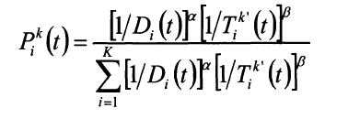
Adaptive Probabilistic path Selection in Multipath Routing
Dynamic Probability
Compute the probability affected to each path automatically
For the router x, the set {1,….N} of N best paths found at time t,probability P_{i}^{k} (t) for the i^{th} path in the router K at time t:
D_{i}(t)- packet delivery time for path I at time t.
T_{i}^{k’}(t)-latency in queuing file associated to closet router k’
This version of algorithm is named as KSPQR-VDY in the paper

Slide 14
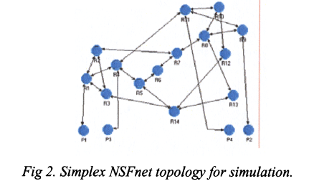
Numerical Results
Topology
NSFnet
Traffic is sent receive by four end notes composed of 14 router And 21 bidirectional bonds

Slide 15
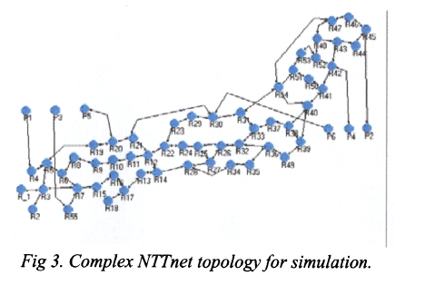
Topology
NTTnet
More complex
55 interconnected routers and 162 bidirectional bonds

Slide 16
Traffic Model
Request are assumed to arrive independently at each node, following Poisson distribution.
For simplicity error management, flow and congestion control is not implemented
Behavior of algorithm is evaluated in isolation.

Slide 17
Comparative study
Compare against two well known classical approach:
Shortest Path First(SPF)
Open Shortest Path First(OSPF)

Slide 18
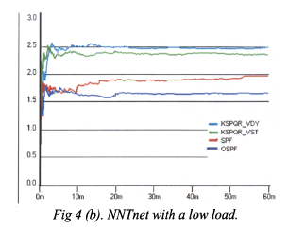
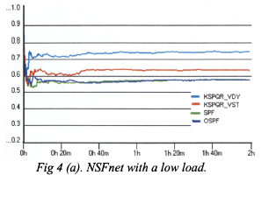
Simulation with Low Load

Slide 19
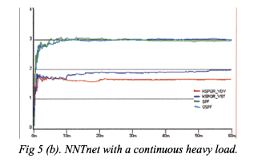
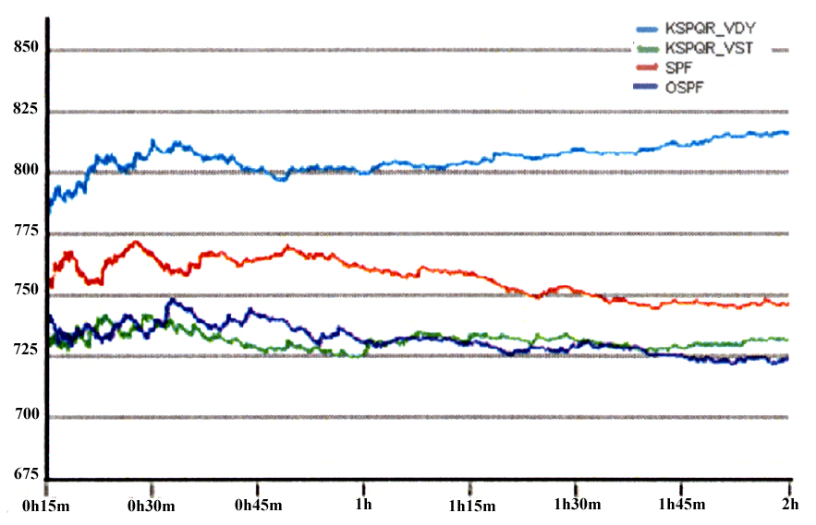
Simulation with heavy load
Fig 5(a). NSFnet with a continuous heavy load

Slide 20
Conclusion
N-best optimal path is computed with Dijkstra’s algorithm
Learning algorithm is based on found N-best path in terms of cumulative link cost and optimization of the average delivery times on these links.
Proves to be superior to classical algorithms
Route efficiently in large networks even when critical aspects are allowed to vary dynamically.

Slide 21
Questions?

